Slide 1

Internet Safety
Gurpreeti Kaur Krothe

Slide 2

What will we learn today?
Online friends
Online consent
Sharing images and videos online including the law
How to get help online and offline
How to report online
Notes:
Online friendships
Sharing images and videos including the law
Responding if pressured online, understanding the importance of consent
Understand the importance of seeking help online and from a trusted adult

Slide 3

ACTIVITY
What do we think is good and bad about the internet?

Slide 4
`Have you ever been worried about something that has happened online or you saw online?
Notes:
What kind of things have worried you?

Slide 5

Online friendships

Slide 6
How do you make friends online?
What information do you share with your friends online?
How do you stay safe online with friends or when making new friendships?

Slide 7
Choose who you speak to online
It is safer to talk to people you know in person online such as friends from school
It's always ok not to reply. If a message makes you feel worried, annoyed or upset, don't reply and tell an adult you trust.
If someone you are chatting to is being mean or making you feel uncomfortable, tell an adult you trust. They will help you block and report them so that they can't contact you again.
You can also try to delete or block the person yourself, if you know how to.

Slide 8

Online Consent

Slide 9

What does online consent mean?
How do you give consent online?

Slide 10

Take control of who sees your information: ask an adult to help you change the Privacy Settings on your accounts.
Keep your passwords secret.
Make sure apps, games and websites don’t tell other people your location. Ask an adult to help you switch off the location setting on your phone, tablet or computer.
Think about what information you share online and who may see it.

Slide 11
https://www.youtube.com/watch?v=HxySrSbSY7o

Slide 12
Sharing images or videos

Slide 13
What types of things do you like to share online?
Is there anything you would not share? Why?
What would you tell or say to a friend if someone shared a picture or video of them online, without asking their permission (if they were okay with this)?

Slide 14

Okay or not okay?
Sukhdev shares a picture of Claire online without asking her, he then sends it to his friends
Tom shares a video of John dancing in his underwear on his Snapchat story
Lisa says to Lucas, she will stop speaking to him if he does not send her pictures of himself
Aliyah sends pictures and videos of herself in her underwear to a person she likes/fancies

Slide 15
What does the law say?
It is against the law in the UK to share naked or sexually explicit image or video of yourself with others if aged under the age of 18 (you can get into trouble with the police)
It is also against the law to show your friends or share images or videos with your friends
It is against the law to create a sexually explicit image or video if you are under 18 or have it on your device
Do you know what else is illegal to share with others?
Notes:
If someone has shared a nude of you online, you can report it to CEOP and ask for it to be taken down

Slide 16
It is important to be careful what you share online
Think before you share or comment online; who might see what you have shared or wrote? Who might see your photo or video?
If someone you don’t know asks you to share a photo or video or go on camera, don't reply, and tell an adult you trust.
Worried about something you’ve shared online or sent to someone? Ask an adult you trust for help.

Slide 17

Where can I go for help?

Slide 18

Sometimes things happen online that make us feel scared, upset or worried.
It is important you tell an adult you trust what has happened to you and how you feel. They will be able to help you.

Slide 19
ACTIVITY
Who are adults you trust?
Notes:
activity

Slide 20
Think of an adult that makes you feel safe to get help. They might be:
A school teacher or another adult in the school
A parent or carer – mum, dad
Another family member
Another adult who looks after you
If after speaking to this adult, you still feel you need help, you can tell another adult you trust.

Slide 21
Here are examples of how to ask an adult for help
Grandma, I feel upset. Can I talk to you?
Miss or Sir, can I talk to you about something I am worried about?
Dad/ Mum something happened when I was online. Can you help me?

Slide 22
It is important to remember to always tell a trusted adult if someone is:
Putting pressure on you to do something that does not feel right, you do not like or feel scared to do
Saying something bad will happen if you don’t listen and do what they say
If they are saying they will give you something in return, e.g. money, access to an online game.

Slide 23

How to report online?

Slide 24

Other places you can get help?

Slide 25

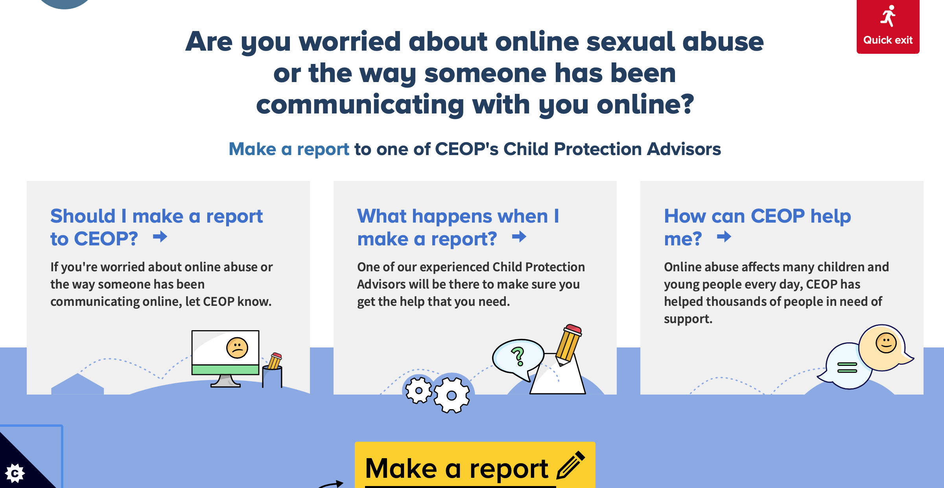

https://www.ceop.police.uk/ceop-reporting/

Slide 26
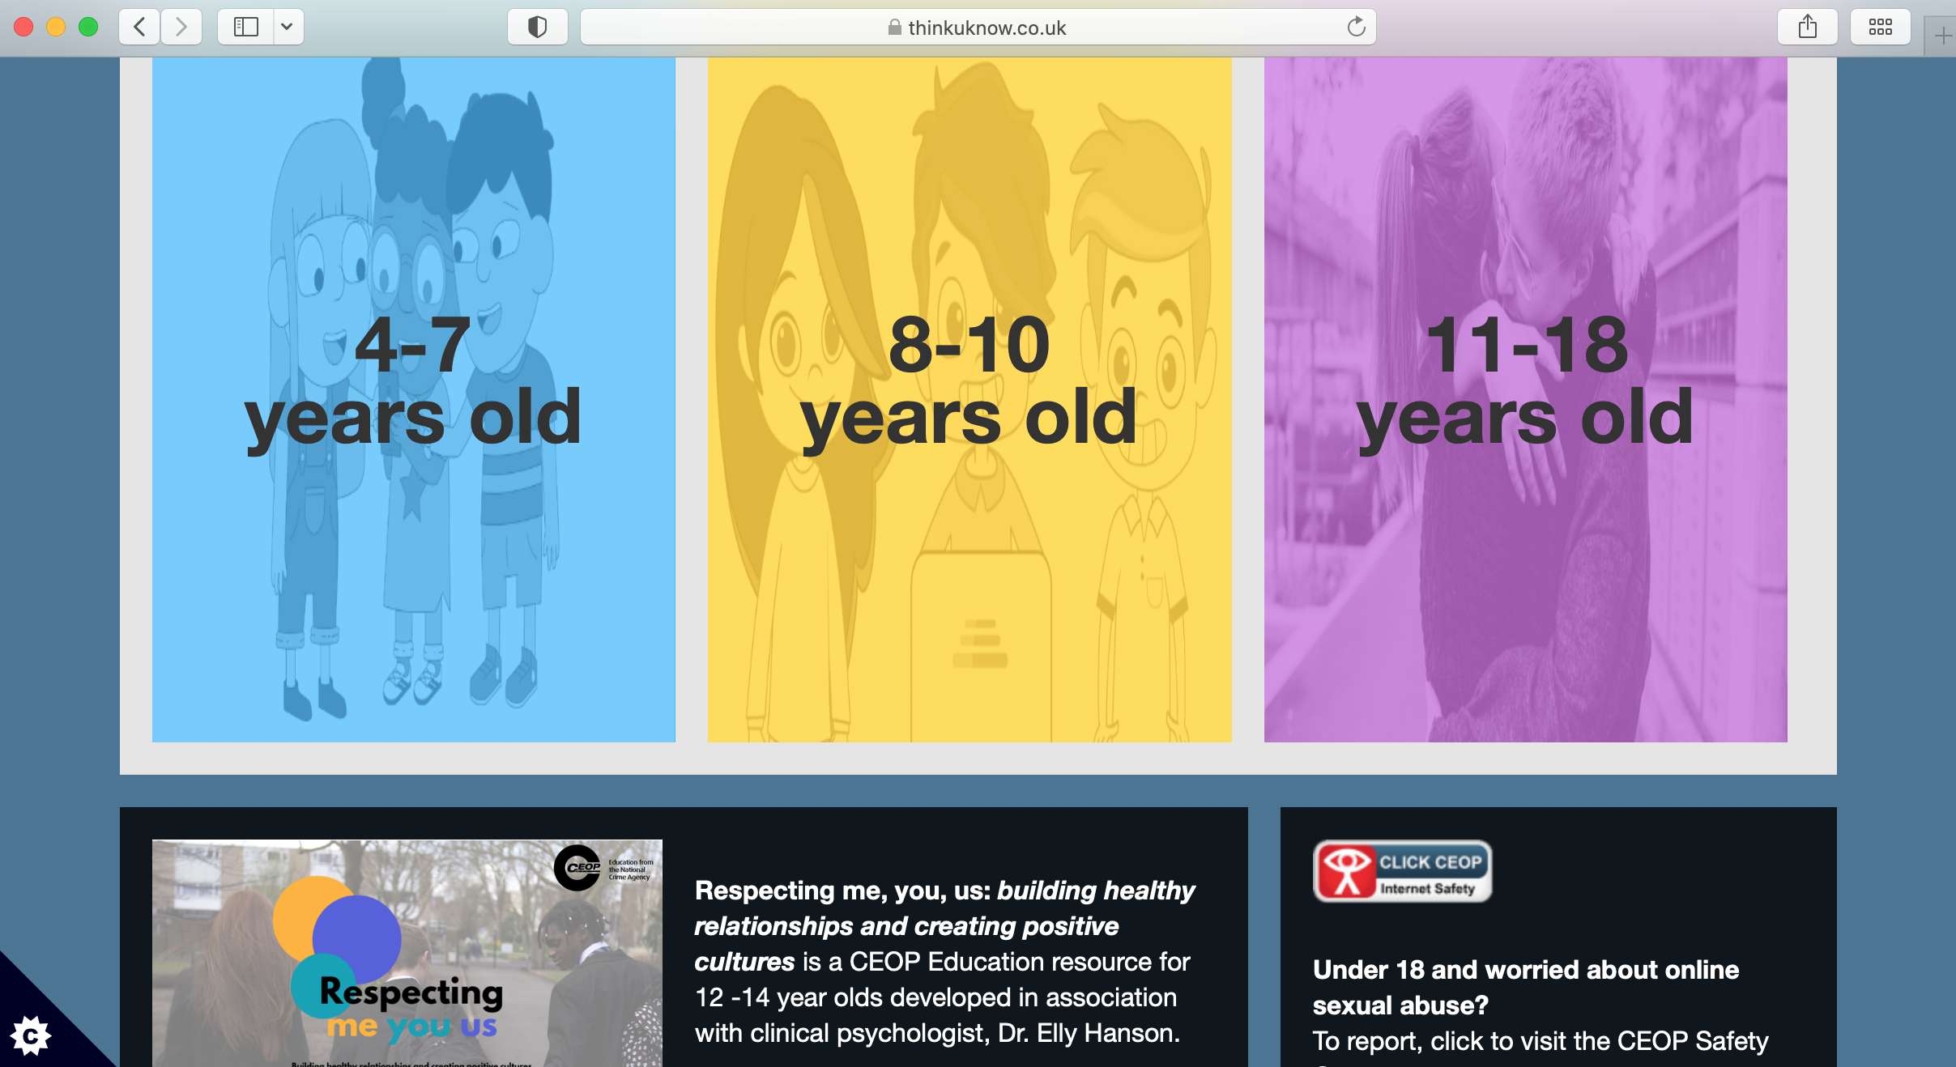
thinkuknow

Slide 27
Well done!

