Slide 1
Online Safety
What are the risks?
The current risks and issues in our school
How to keep your child safe at home

Slide 2
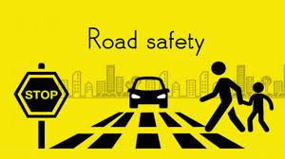

What are the risks?
The internet can be a powerful force for good, but illegal and harmful content and activity is widespread online. 62% of adult internet users and over 80% of children (aged 12-15) have had potentially harmful experiences online. The prevalence of the most serious illegal content and activity - which threatens the physical safety of children - is unacceptable.
In 2020, nearly 22 million reports of child sexual exploitation were made to the National Centre for Missing and Exploited Children, including over 65 million images, videos and other files. Online platforms can be a tool for abuse and bullying, and the impact of harmful content and activity is particularly damaging for children.

Slide 3


What are the risks?

Slide 4
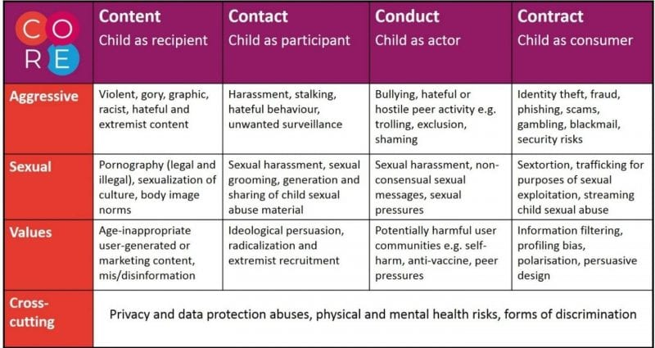
What are the risks?

Slide 5


Slide 6
What are the risks?

Slide 8
What are the risks?

Slide 9

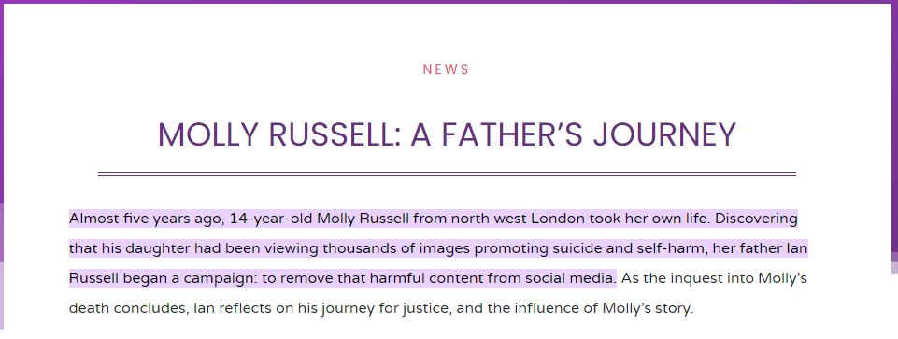
What are the risks?

Slide 10
What are the risks?

Slide 11


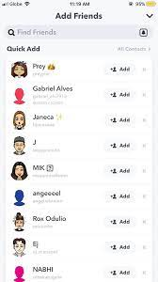

The current risks and issues in our school

Slide 12
How to help keep your child safe at home
Not all risk can be removed
Talk – have an open channel of communication with your child. Make sure they know your actions are to keep them safe!
Agree: Phones are a privilege, where can they be used and when can they be used?
Set: Parental controls, location settings, privacy settings
Check: passwords, chats, apps, search and video history
Take the time: discuss risks and issues that arise
Feedback: Praise, explain, remove

Slide 13
How to help keep your child safe at home
Be a good role model
Resources
Ask for help
Our School website: About > Online Safety
If your child is using social networking sites to chat to friends and family or share their latest selfie, take a look at this list of social media guides to get you up to speed on the most popular platforms and help them set the right privacy settings.
Internet Matters
This website shows App information for the most popular social media, video, photo, Lifestyle and gaming apps used by kids today.
Protect Young Eyes

